Slide 1
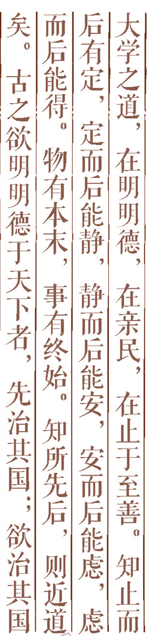
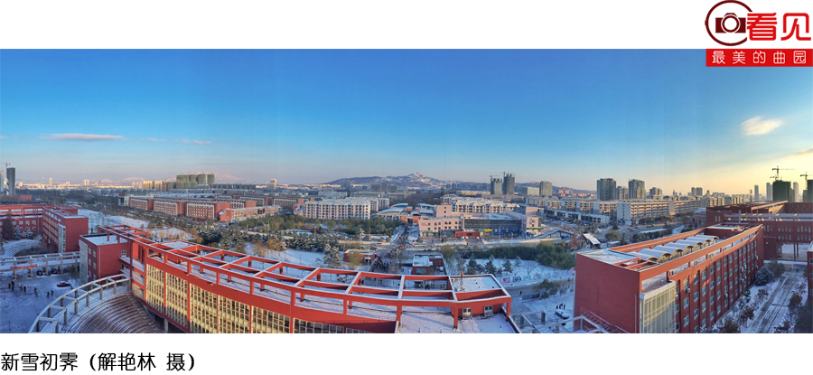

Artificial Intelligence Chapter 17. Knowledge-Based Systems
Chapter 17 第2讲

Slide 2



Confronting the Real World
Reasoning Using Horn Clauses
Maintenance in Dynamic Knowledge Bases
Prolog Language
Rule-Based Expert Systems
Rule Learning
Additional Readings and Discussion
Outline

Slide 3
Please ask as many questions as you can?
Frame1
Zhangxin
{
Sex：Male
Date of birth: 2002-10-1
Height：180cm
Occupation：Teacher
….
}
Frame2
Liming
{
Sex：Female
Date of birth: 2012-10
Height：162cm
Occupation：Student
….
}
Frame3
Wangqiang
{
Sex：Male
Date of birth: 1988-10-1
Height：176cm
Occupation：Engineer
….
}

Slide 4
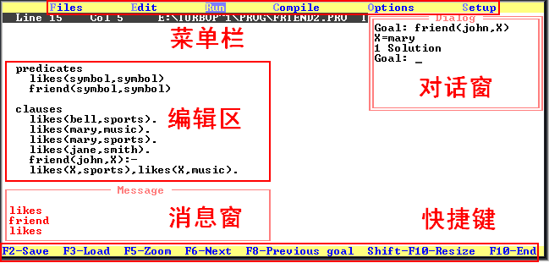
4. Turbo Prolog

Slide 5
4.1 Basic Syntax of Turbo Prolog
constants <常量说明语句> /* <注释> */
domains <领域说明语句>
database <数据库说明语句>
predicates <谓词说明语句>
clauses <子句语句>
goal <目标语句>

Slide 6
domains
name,thing=symbol
predicates
likes(name,thing)
friend(name,thing)
clauses
likes(xiaofang,badminton).
likes(xiaoming,pingpong).
friend(X,xiaohua):-likes(X,pingpong).
goal
friend(X,xiaohua),write(X," is xiaohua's friend.").

Slide 7
4.2 Examples of Turbo Prolog—Example 1
likes(bell,sports).
likes(mary,music).
likes(mary,sports).
likes(jane,smith).
friend(john,X):-likes(X,reading),likes(X,music).
friend(john,X):-likes(X,sports),likes(X,music).
?-friend(john,Y).
Goal
friend(john,Y).
New goals
likes(X,reading),likes(X,music).

Slide 8
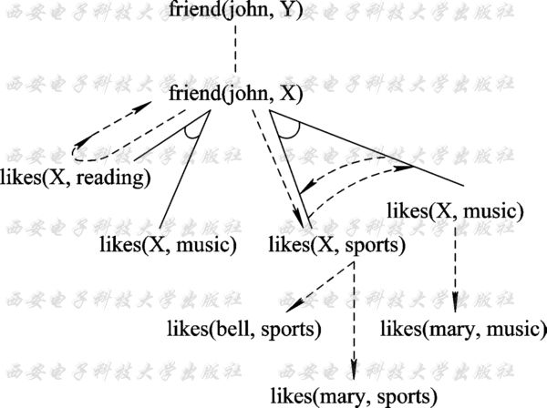

Slide 9
4.2 Examples of Turbo Prolog—Example 2
Sum=x+y
Program：
goal
readint(X), /*输入一个整数给X*/
readint(Y), /*输入一个整数给Y*/
Z=X+Y,
write(X,"+",Y,"=",Z),nl. /*输出计算结果Z*/

Slide 10
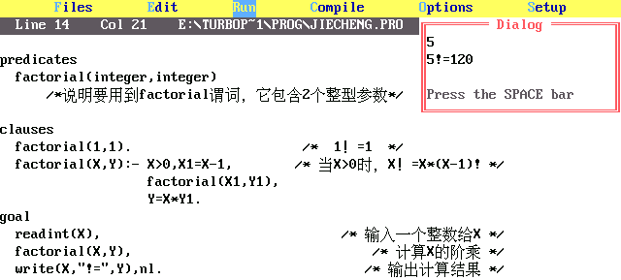
4.2 Examples of Turbo Prolog—Example 3
n!=n*(n-1)*(n-2)*…*3*2*1

Slide 11
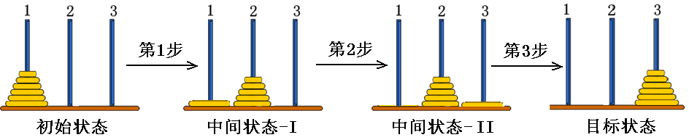
4.2 Examples of Turbo Prolog—Example 4

Slide 12
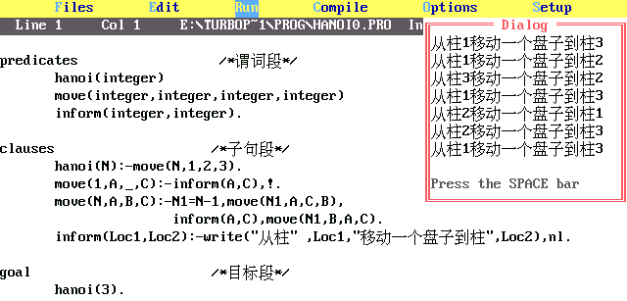
4.2 Examples of Turbo Prolog—Example 4

Slide 13
5. Rule-Based Expert Systems
1、What is an expert system (ES)? Expert System: Knowledge intensive computer program that captures the expertise of a human in limited domains of knowledge.

Slide 14
Expert systems provide expert quality advice, diagnoses and recommendations on real world problems.
ES performs a task in limited domains that require human expertise.
e.g.medical diagnosis; fault diagnosis; status monitoring; data interpretation; mineral exploration; credit checking; tutoring; computer configuration.

Slide 15
Examples:
Medical diagnosis - program takes place of a doctor; given a set of symptoms the system suggests a diagnosis and treatment
Car fault diagnosis - given car's symptoms, suggest what is wrong with it.

Slide 16
Domain knowledge is acquired by interviewing human experts.
ES solves problems by application of domain
specific knowledge rather than weak methods.
ES can explain a problem solution in human-understandable terms
ES cannot operate in situations that call for common sense

Slide 17
2、what is Rule-based expert system?
Rule-based expert system: An AI program that has a large number of interconnected and nested IF-THEN statements, or rules, that are the basis for the knowledge in the system.

Slide 18
3、Structure of Expert System
User
Expert/s
Knowledge engineer
Human-computer interface
Knowledge
acquisition
subsystem
Explanation
subsystem
Knowledge
base
Inference
engine

Slide 19
Knowledge base: Model of human knowledge that is used by expert systems.
Rule base: The collection of knowledge in an AI system that is represented in the form of IF-THEN rules.
Inference engine: The strategy used to search through the rule base in an expert system; can be forward or backward chaining.
Knowledge Engineer: A specialist who elicits information and expertise from other professionals and translates these knowledge into a set of rules or frames for an expert system.

Slide 20
E.G 1:Expert system for Headache （感冒专家系统）
Headache

Slide 21
Rule base
If ‘病位’=‘头部’and ‘流鼻涕’and ‘头晕’
Then ‘病’=‘感冒刚起’
If ‘病位’=‘头部’and ‘鼻塞’and ‘浑身无力’, Then ‘病’=‘感冒’
If ‘病位’=‘头部’and ‘发烧’and ‘头晕’and ‘扁桃体肿’, Then ‘病’=‘严重感冒’

Slide 22
/*----------------- 感冒 处方----------------*/
If ‘病位’=‘头部’and ‘感冒刚起’
Then ‘处方’=‘服用速效伤风胶囊，日服三次，每次一颗。’
If ‘病位’=‘头部’and ‘一般感冒’
Then ‘处方’=‘服用感冒通，日服三次，每次三颗。’
If ‘病位’=‘头部’and ‘严重感冒’
Then ‘处方’=‘注射青霉素，日注射两次，每次80万单位。’

Slide 23
1. Forward reason
服用感冒通，日服三次，每次三颗
头部、鼻塞、浑身无力
Human-computer interface
DB
头部、鼻塞、浑身无力 一般
感冒服用感冒通，日服三次，每
次三颗
KB
If ‘病位’=‘头部’and ‘鼻塞’and ‘浑身无力’
Then ‘病’=‘感冒’
If ‘病位’=‘头部’and ‘一般感冒’
Then ‘处方’=‘服用感冒通，日服三次，每次三颗。’
Inference
engine

Slide 24
2. Explanation subsystem
HOW？(你是如何得出结论的）
您说“头部”、“鼻塞”、“浑身无力”，由规则A，您是“ 一般感冒”；又由规则B您需服用感冒通。
Interface
头部、鼻塞、浑身无力 一般
感冒, 服用感冒通，日服三次，
每次三颗
解释模块
A. If ‘病位’=‘头部’and ‘鼻塞’and ‘浑身无力’
Then ‘病’=‘感冒’
B. If ‘病位’=‘头部’and ‘一般感冒’
Then ‘处方’=‘服用感冒通，日服三次，每次三颗。’

Slide 25
4、Where do the rules come from ?
Manual Knowledge Acquisition
Automated Knowledge Acquisition

Slide 26
Manual Knowledge Acquisition
interview experts
expert describes the rules
process of translating expert knowledge into a formal representation is also known as knowledge engineering
this is notoriously difficult
experts are often very poor at explicitly describing what they do
e.g., ask Michael Jordan how he plays basketball or ask Tiger Woods how he plays golf

Slide 27
Automated Knowledge Acquisition
derive rules automatically from formal specifications
e.g., by automatic analysis of solution manuals
Machine learning
learn rules from data

